Slide 1
Measurement of Temperature Using RTD

Slide 2
What is a RTD?
A Resistance Temperature Detector (also known as a Resistance Thermometer or RTD) is an electronic device used to determine the temperature by measuring the resistance of an electrical wire.
RTD’s are of two types
Negative Temperature Coefficient(NTC)
Positive Temperature Coefficient(PTC)

Slide 3
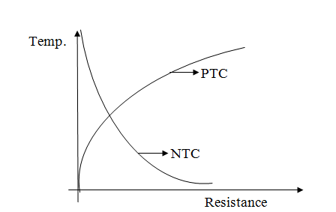
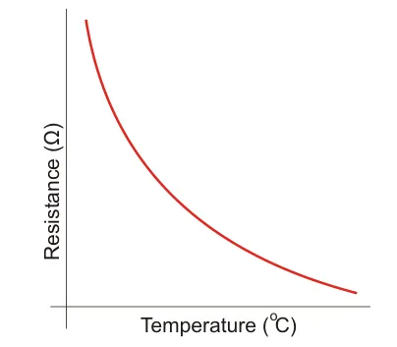
RTDs

Slide 4
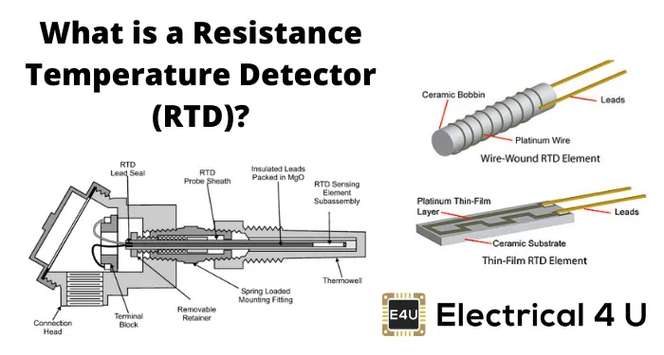
RTDs

Slide 5
Element Characteristics
Change in resistance of material per unit change in temperature should be as large as possible.
High Value of resistivity to minimize volume
Resistance of material should have continuous and stable relationship with temperature

Slide 6
Element Types
The three main categories of RTD sensors are thin-film, wire-wound, and coiled elements
Carbon resistor elements
These are cheap and widely used.
They have very reproducible results at low temperatures.
They are the most reliable form at extremely low temperatures.
They generally do not suffer from hysteresis.
Strain-free elements
Strain-free elements use a wire coil within a sealed housing filled with an inert gas.
They consist of platinum wire loosely coiled over a support structure, so the element is free to expand and contract with temperature.
They are very susceptible to shock and vibration, as the loops of platinum can sway back and forth, causing deformation.

Slide 7
Element Types
Thin-film elements
Formed by depositing a very thin layer of resistive material, normally platinum, on a ceramic substrate (plating).
This layer is usually just 10 to 100 angstroms (1 to 10 nanometers) thick.
This film is then coated with an epoxy or glass that helps protect the deposited film and also acts as a strain relief for the external lead wires.
Disadvantages of this type are that they are not as stable as their wire-wound or coiled counterparts.
They also can only be used over a limited temperature range due to the different expansion rates of the substrate and resistive deposited giving a "strain gauge" effect that can be seen in the resistive temperature coefficient.
These elements work with temperatures to 300 °C (572 °F) without further packaging, but can operate up to 600 °C (1,112 °F) when suitably encapsulated in glass or ceramic. Special high-temperature RTD elements can be used up to 900 °C (1,652 °F) with the right encapsulation.

Slide 8
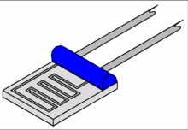
Thin Film RTD
Thin-film elements

Slide 9
Element Types
Wire Wound Elements
Have greater accuracy, especially for wide temperature ranges.
The coil diameter provides a compromise between mechanical stability and allowing expansion of the wire to minimize strain and consequential drift.
The sensing wire is wrapped around an insulating mandrel or core. The winding core can be round or flat, but must be an electrical insulator.
The coefficient of thermal expansion of the winding core material is matched to the sensing wire to minimize any mechanical strain.
This strain on the element wire will result in a thermal measurement error.
The sensing wire is connected to a larger wire, usually referred to as the element lead or wire.
This wire is selected to be compatible with the sensing wire, so that the combination does not generate an emf that would distort the thermal measurement. These elements work with temperatures to 660 °C.

Slide 10
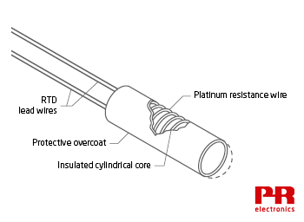
Wire Wound Type RTDs

Slide 11
Element Types
Coil Type elements
They have largely replaced wire-wound elements in industry.
This design has a wire coil that can expand freely over temperature, held in place by some mechanical support, which lets the coil keep its shape.
This “strain free” design allows the sensing wire to expand and contract free of influence from other materials.
The basis of the sensing element is a small coil of platinum sensing wire.
This coil resembles a filament in an incandescent light bulb.
The housing or mandrel is a hard fired ceramic oxide tube with equally spaced bores that run transverse to the axes.
The coil is inserted in the bores of the mandrel and then packed with a very finely ground ceramic powder.
This permits the sensing wire to move, while still remaining in good thermal contact with the process.
These elements work with temperatures to 850 °C.

Slide 12
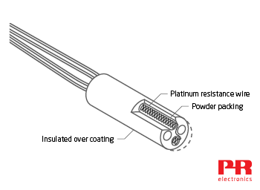
Coil Type RTDs

Slide 13
Applications of RTD
Used in Automotive Industry to measure engine temperature, oil level sensor, intake air temperature sensor
Used in communication and Instrumentation for sensing the temperature of amplifiers, transistor gain stabilizers etc.
Used in power electronics, computers, consumer electronics, food handling and processing, industrial and medical electronics, military and aerospace.

Slide 14
Advantages of RTD
Very stable output
Linearity is higher as compared to thermocouple
High accuracy
Stability maintained over long period of time
No necessity of temperature compensation

Slide 15
Disadvantages of RTD
Slower response time
Self heating possibility
Sensitivity is low
Higher cost

Slide 16
Thermistor vs RTD
Resistance Temperature Detectors are very similar to thermistors.
Both RTDs and thermistors have varying resistance dependent on the temperature.
The main difference between the two is the type of material that they are made of.
Thermistors are commonly made with ceramic or polymer materials while RTDs are made of pure metals.
In terms of performance, thermistors win in almost all aspects.
Thermistors are more accurate, cheaper, and have faster response times than RTDs.
The only real disadvantage of a thermistor vs an RTD is when it comes to temperature range. RTDs can measure temperature over a wider range than a thermistor.

